Slide 1
Final Project Presentation on
AI Interviewer
Name: Shail Patel
CWID: 885175489

Slide 2
Introduction & Purpose
Introduction to AI-Driven Interview Preparation
Background: Traditional interview preparation often fails to address individual needs and lacks interaction.
Objective: To modernize interview training through an AI-driven tool that personalizes preparation based on user profiles.
Key Technologies: Utilizes OpenAI's GPT-4 for realistic scenario simulation and Whisper for speech-to-text to mimic real interactions.
Benefits: Provides dynamic, tailored training that enhances candidate preparedness across various interview types.

Slide 3
Technical Details & Methodology
Leveraging AI for Enhanced Interview Training
AI Technologies: Introduction to how GPT-4 processes natural language and Whisper converts spoken responses to text, enhancing the realism of practice interviews.
Methodology Overview:
Data Engineering: Handling diverse data types including resumes and job descriptions.
Prompt Engineering: Creating context-specific prompts that guide AI to generate relevant questions.
Feature Engineering: Extracting and using features like education and skills from resumes to tailor questions and feedback.

Slide 4
System Workflow & User Interaction
Workflow and User Engagement
System Workflow: Detailed walkthrough from resume upload to receiving feedback, illustrating the step-by-step user journey within the AI system.
User Interaction:
Users can select different types of interviews (behavioral, technical, resume-focused).
Interaction with AI-generated questions based on user's resume and selected job description.
Real-Time Feedback: Highlighting how immediate AI-generated feedback helps users refine their answers and improve interview skills.

Slide 5
Practical Application & Advantages
Real-World Applications and System Benefits
Case Studies: Brief examples or testimonials from users who have significantly improved their interview skills using the AI Interviewer.
Advantages:
Customization to individual needs enhances preparation effectiveness.
Real-time feedback mechanism helps in quick skill enhancement.
Preparation for a wide range of interviews, making users versatile.
User Experience: Share insights into the user-friendly nature of the system and how it has been received by the job-seeking community.

Slide 6
Impact, Conclusions, and Future Directions
Impact: Discussion on how the AI Interviewer has transformed interview preparation, with personalization at its core.
Key Learnings: Reflections on the integration of AI in educational tools and its effectiveness in real-world applications.
Future Directions:
Expansion to more languages and job sectors.
Integration of additional features like career advice and market trends.
Closing Thoughts: Emphasize the project's role in shaping future interview preparation tools and potential adaptations for educational sectors.

Slide 7
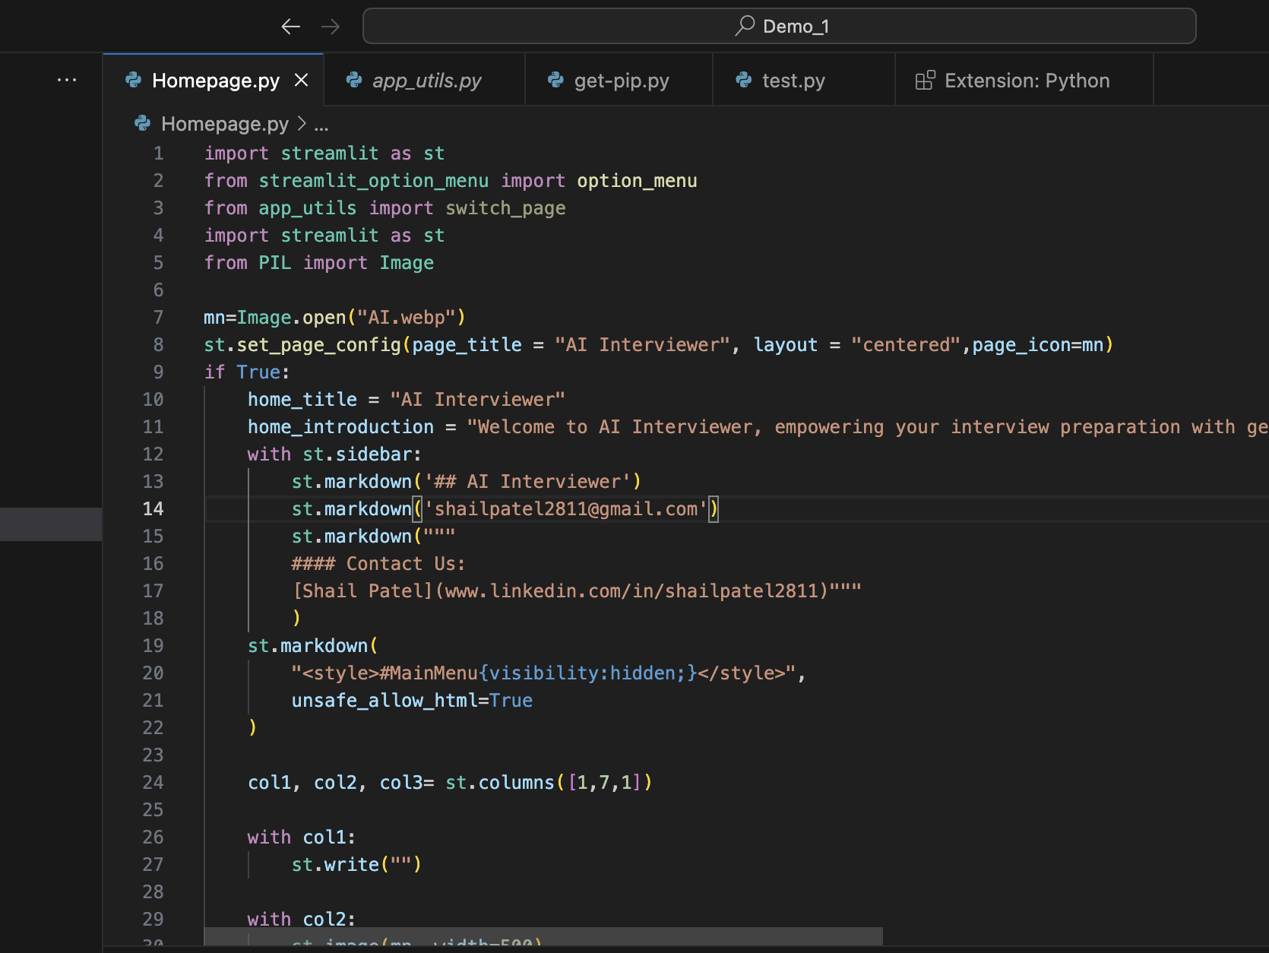
homepage.py

Slide 8
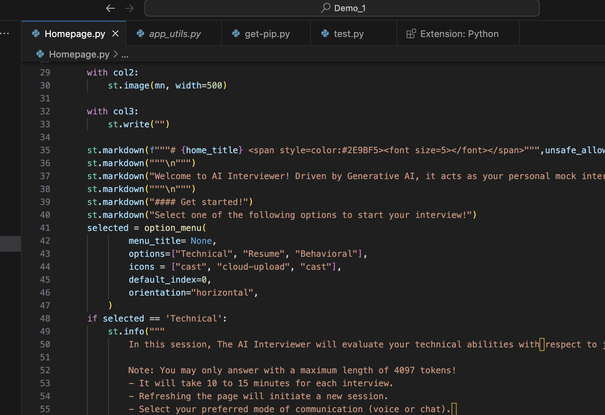

Slide 9
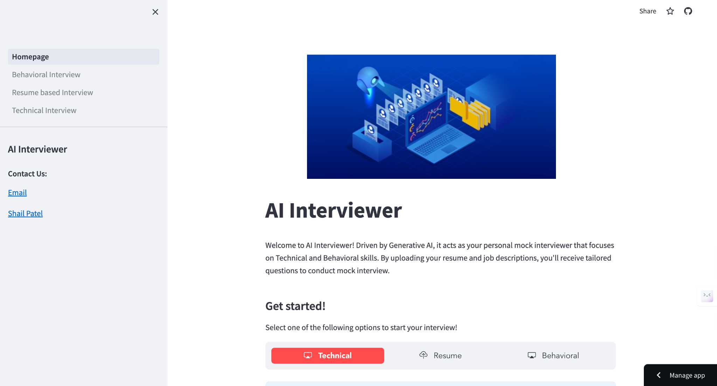

Slide 10
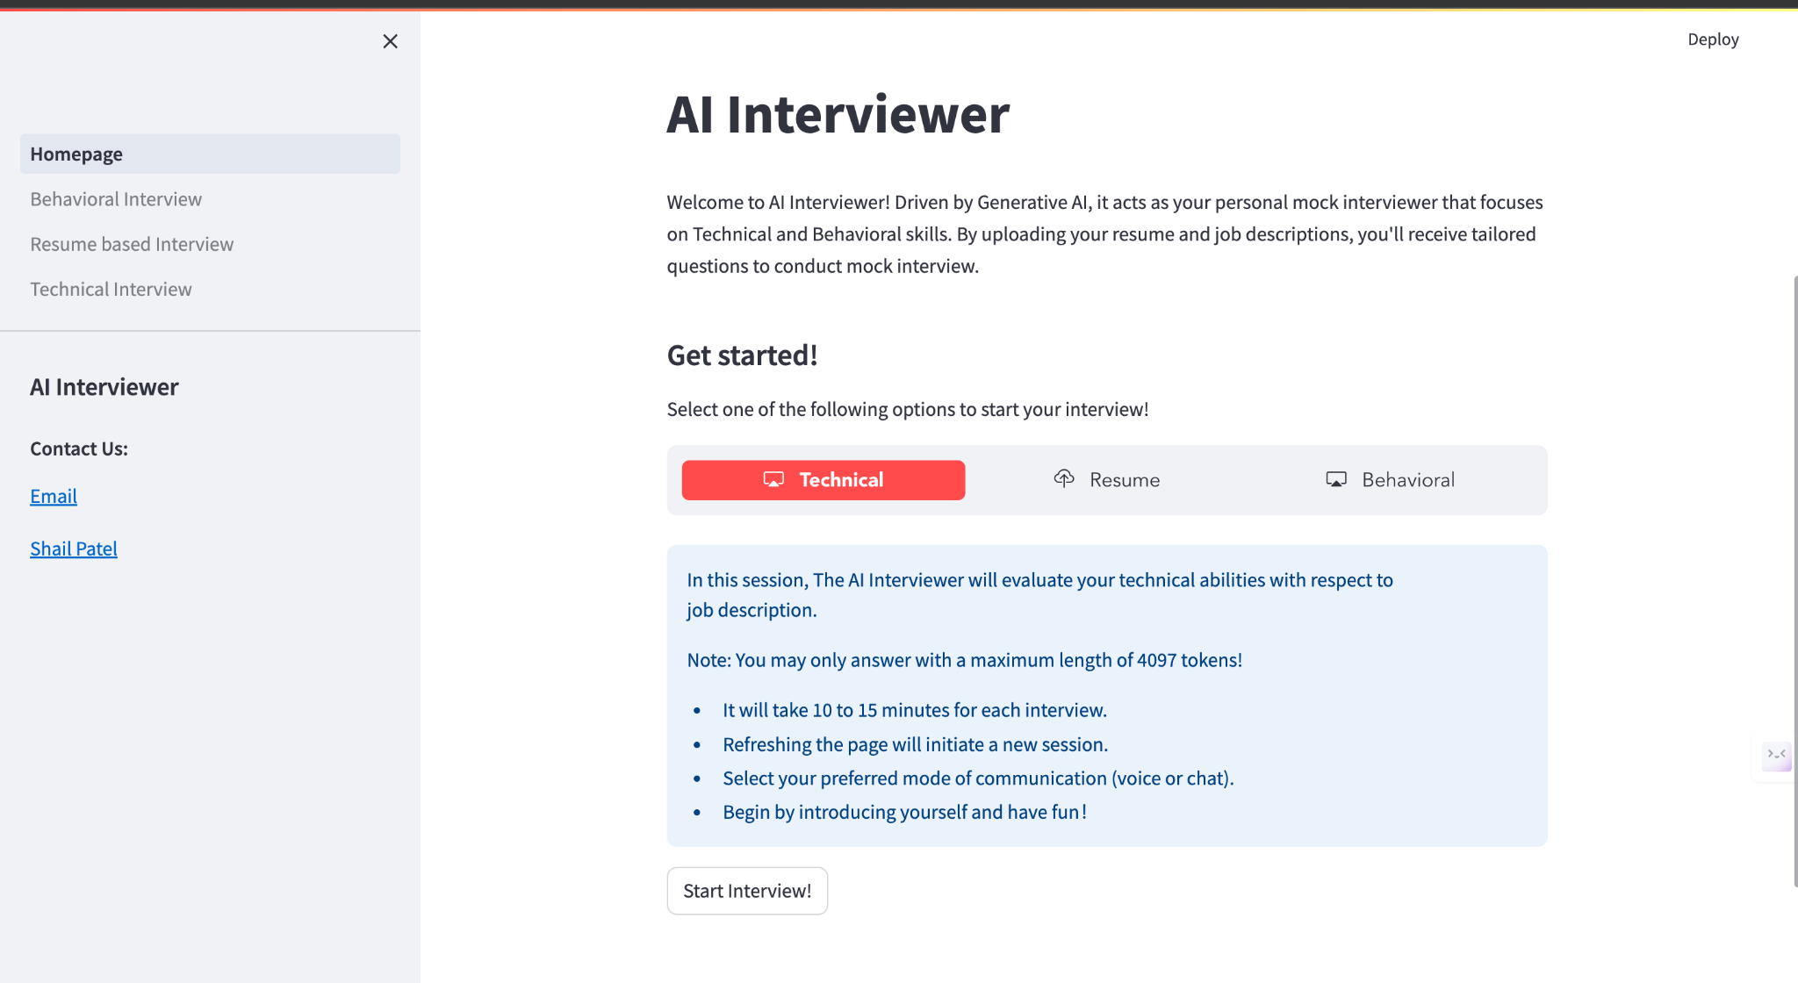

Slide 11
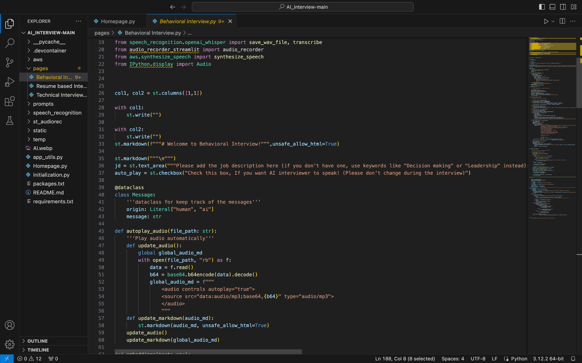
Behavioral Interview Page

Slide 12
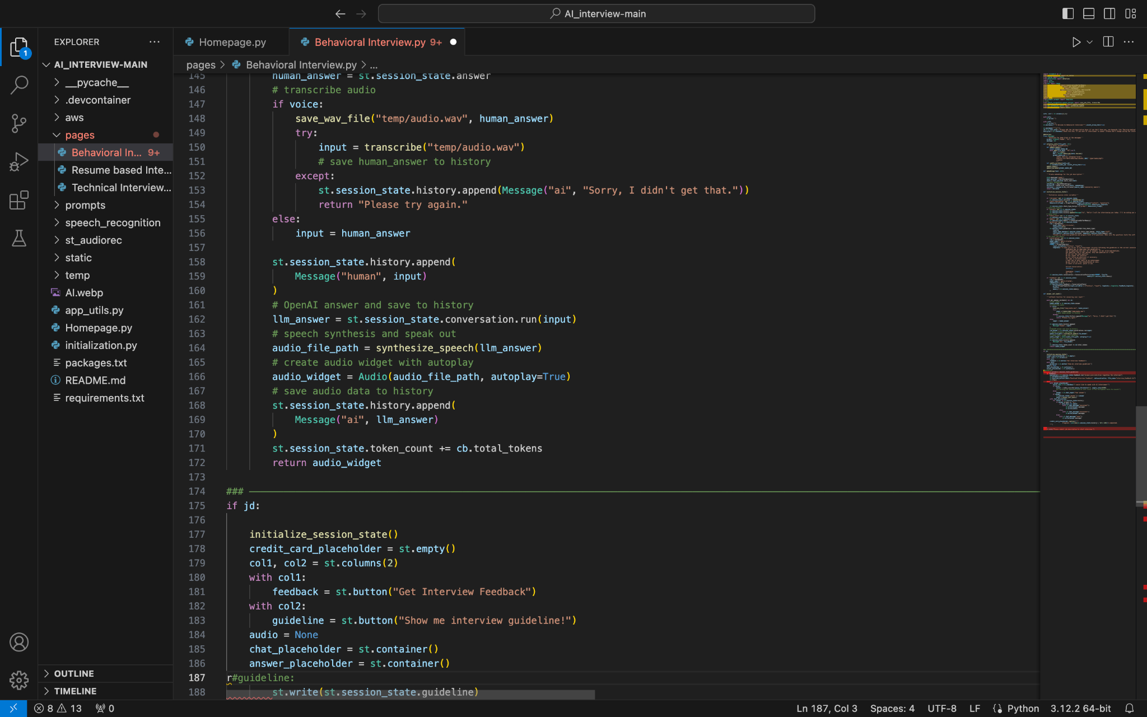

Slide 13
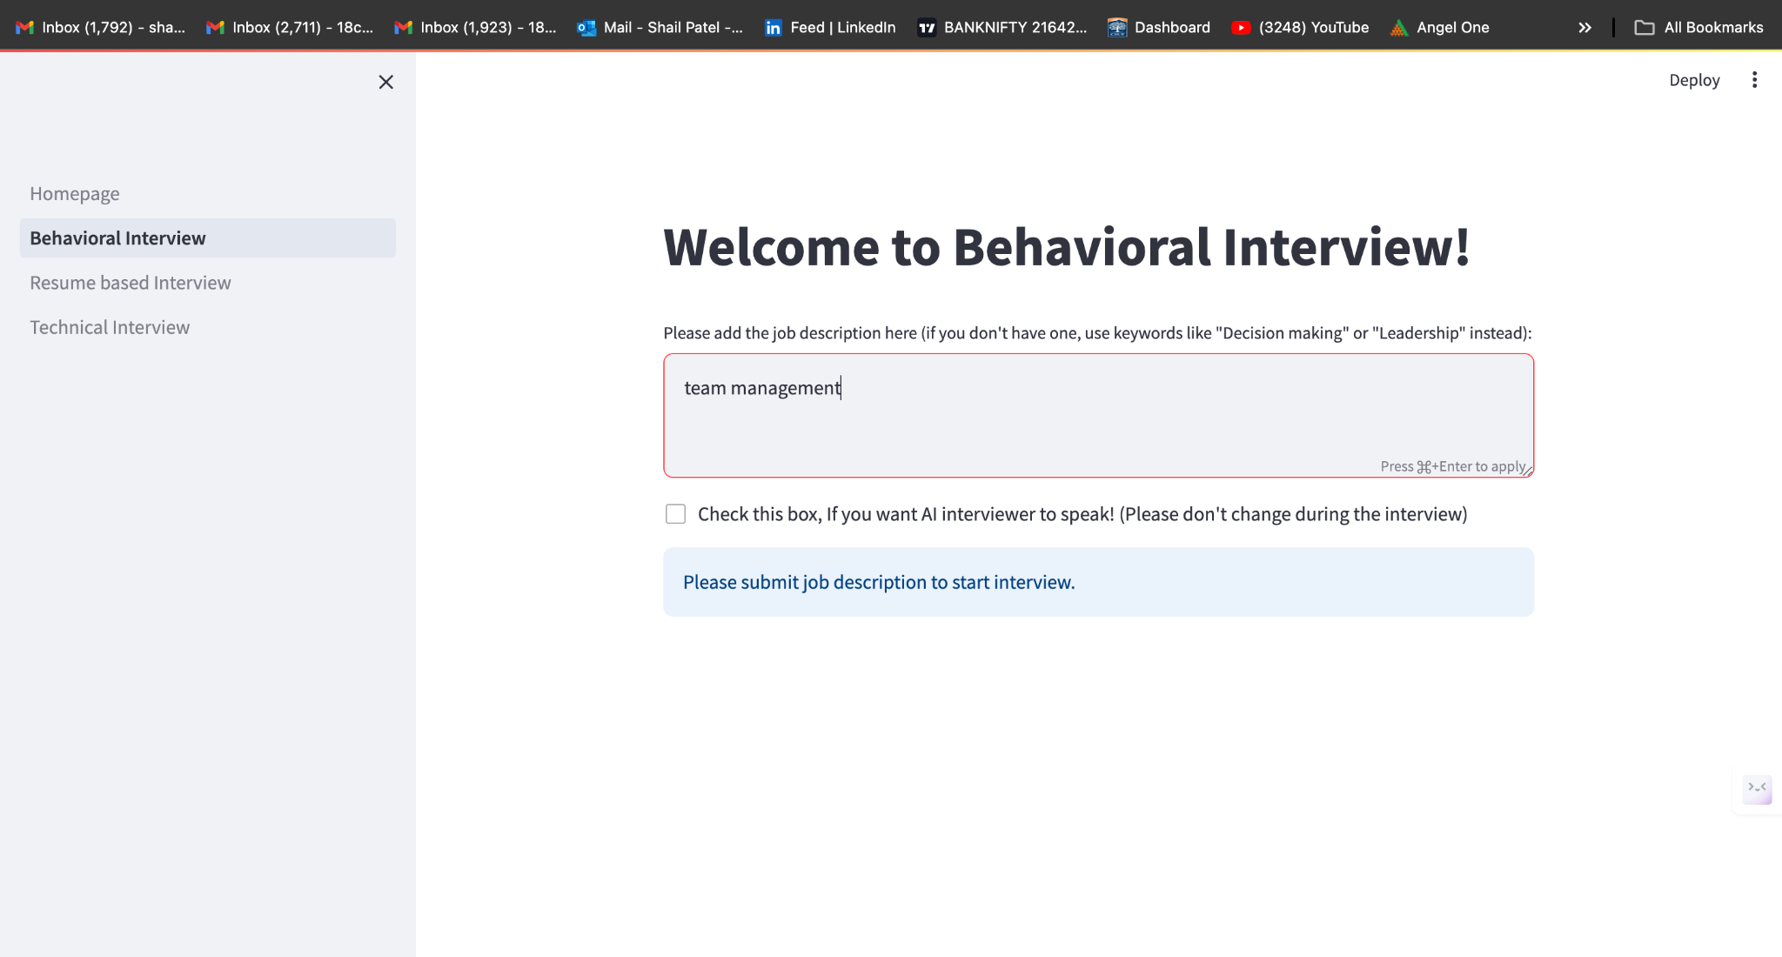

Slide 14
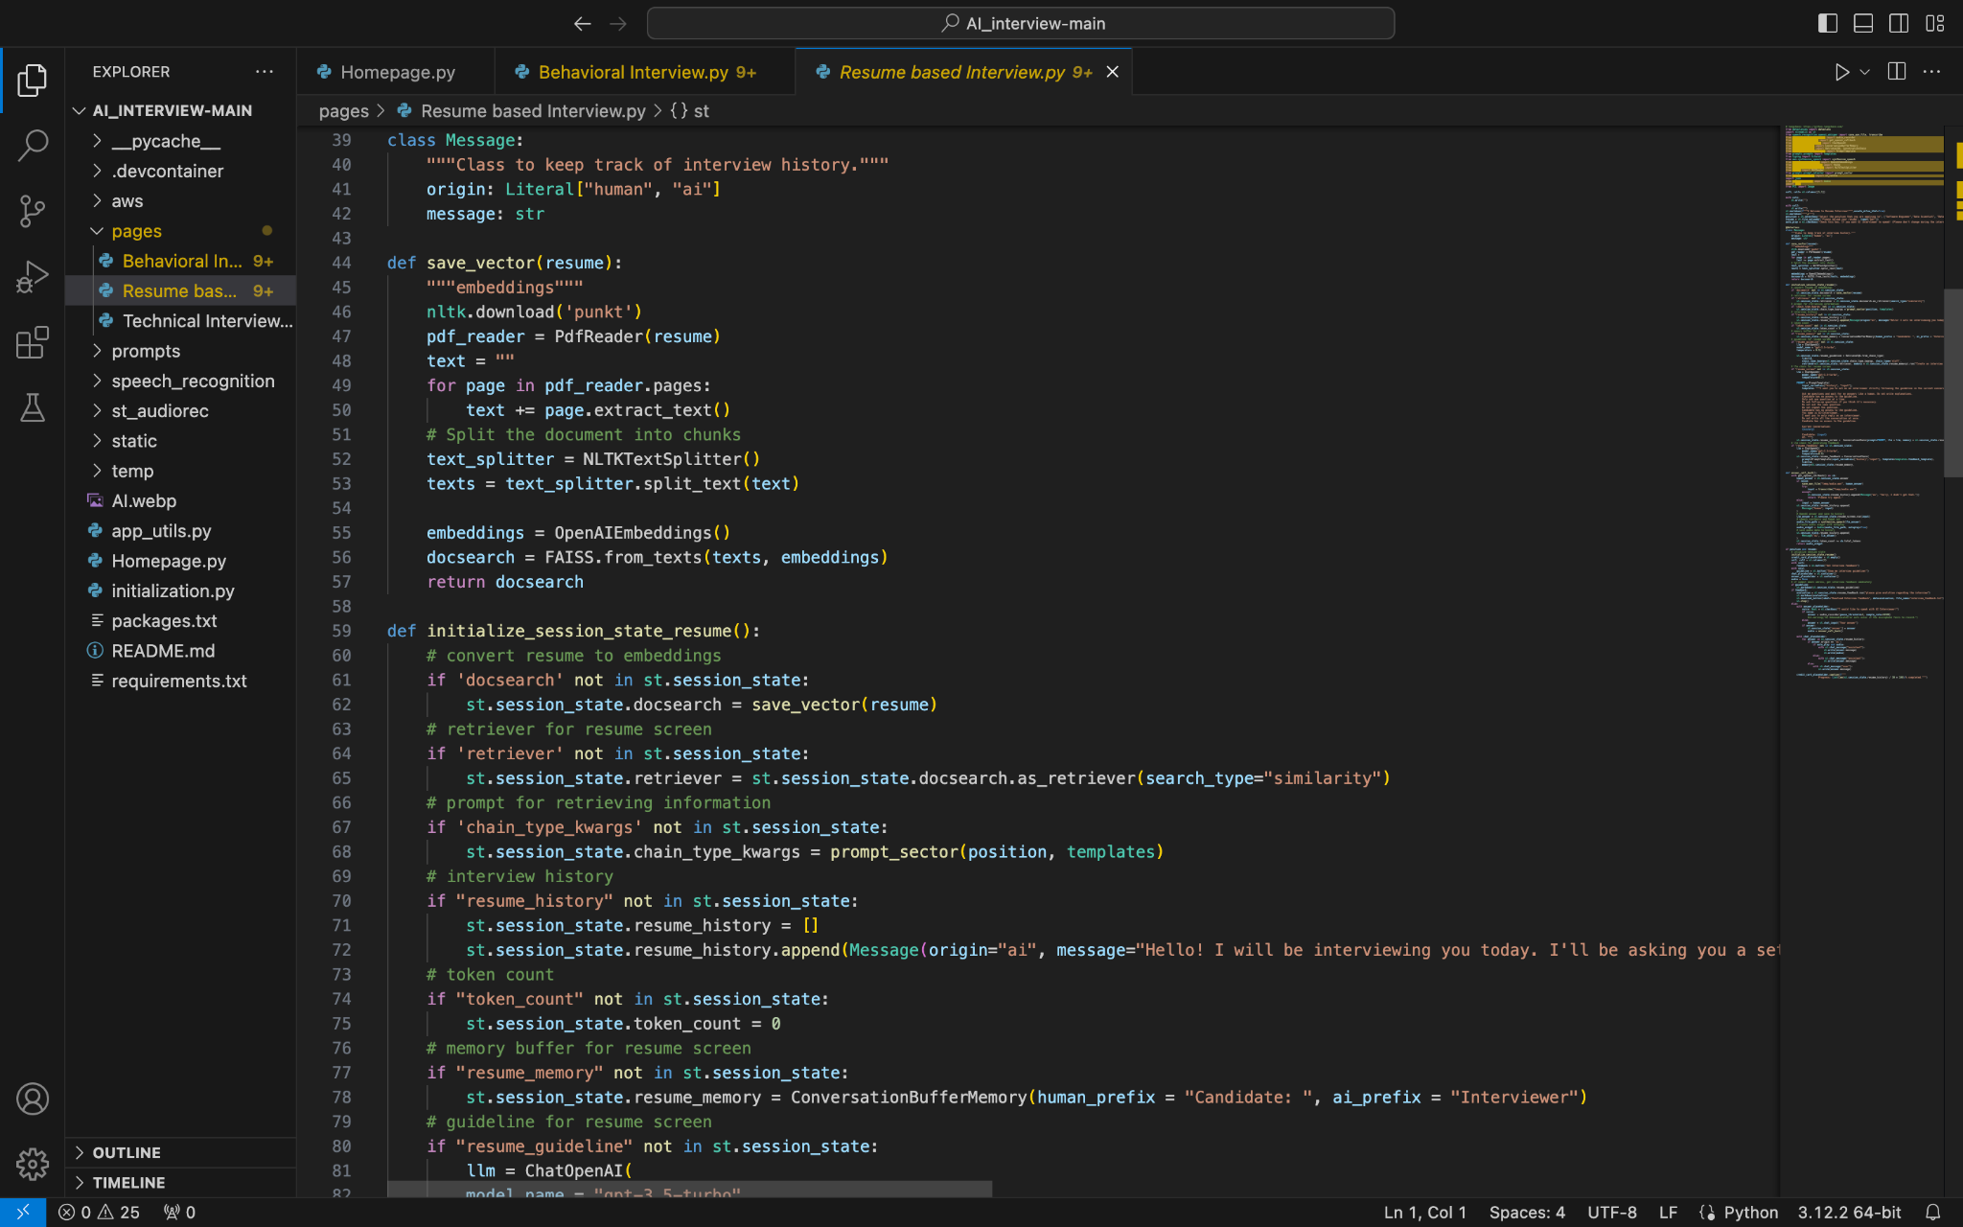
Resume Based Interview Page

Slide 15
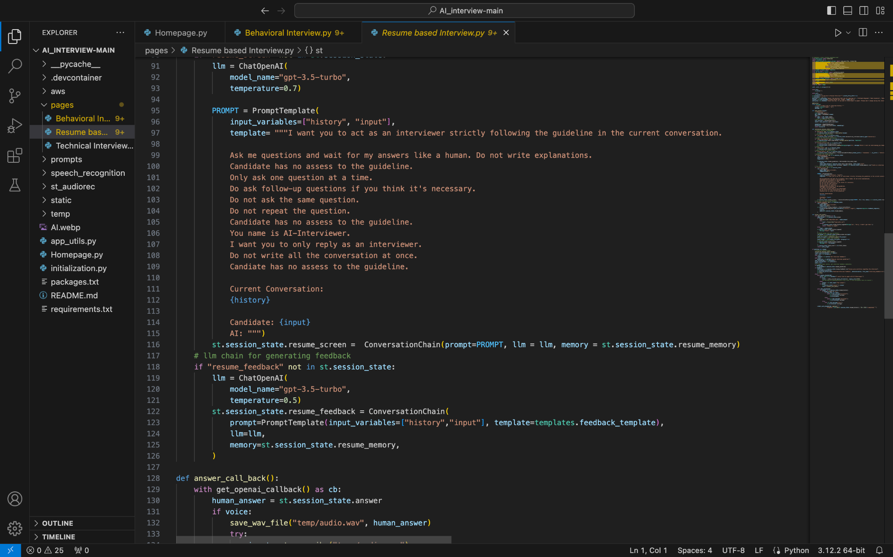

Slide 16
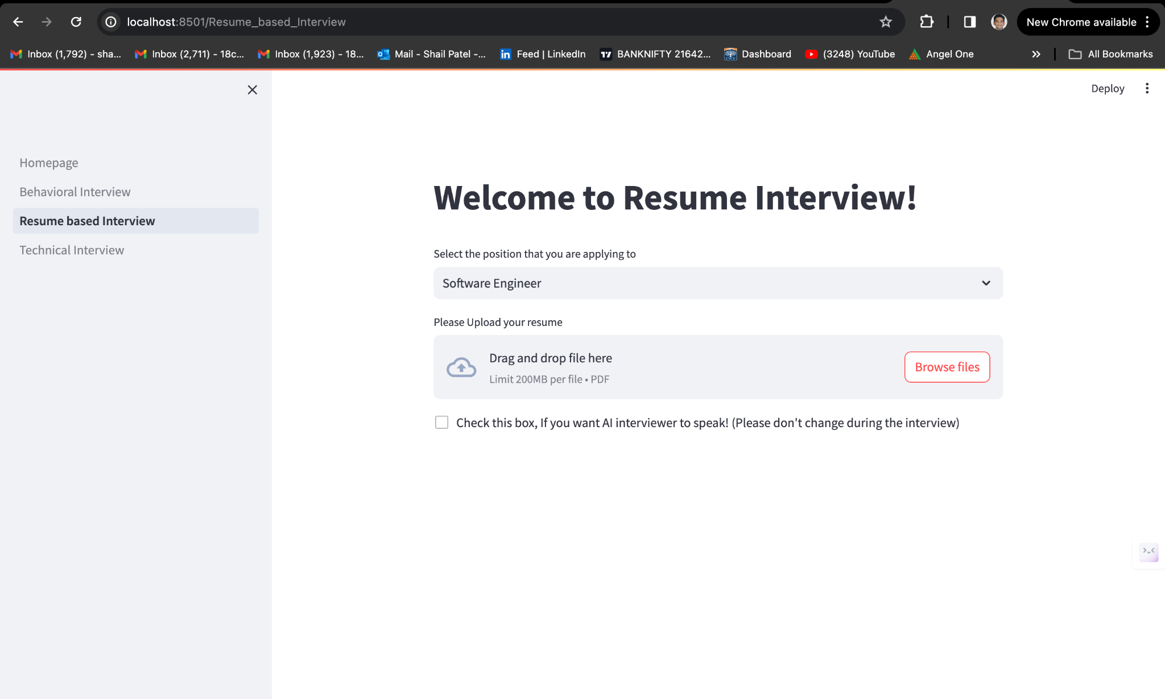

Slide 17
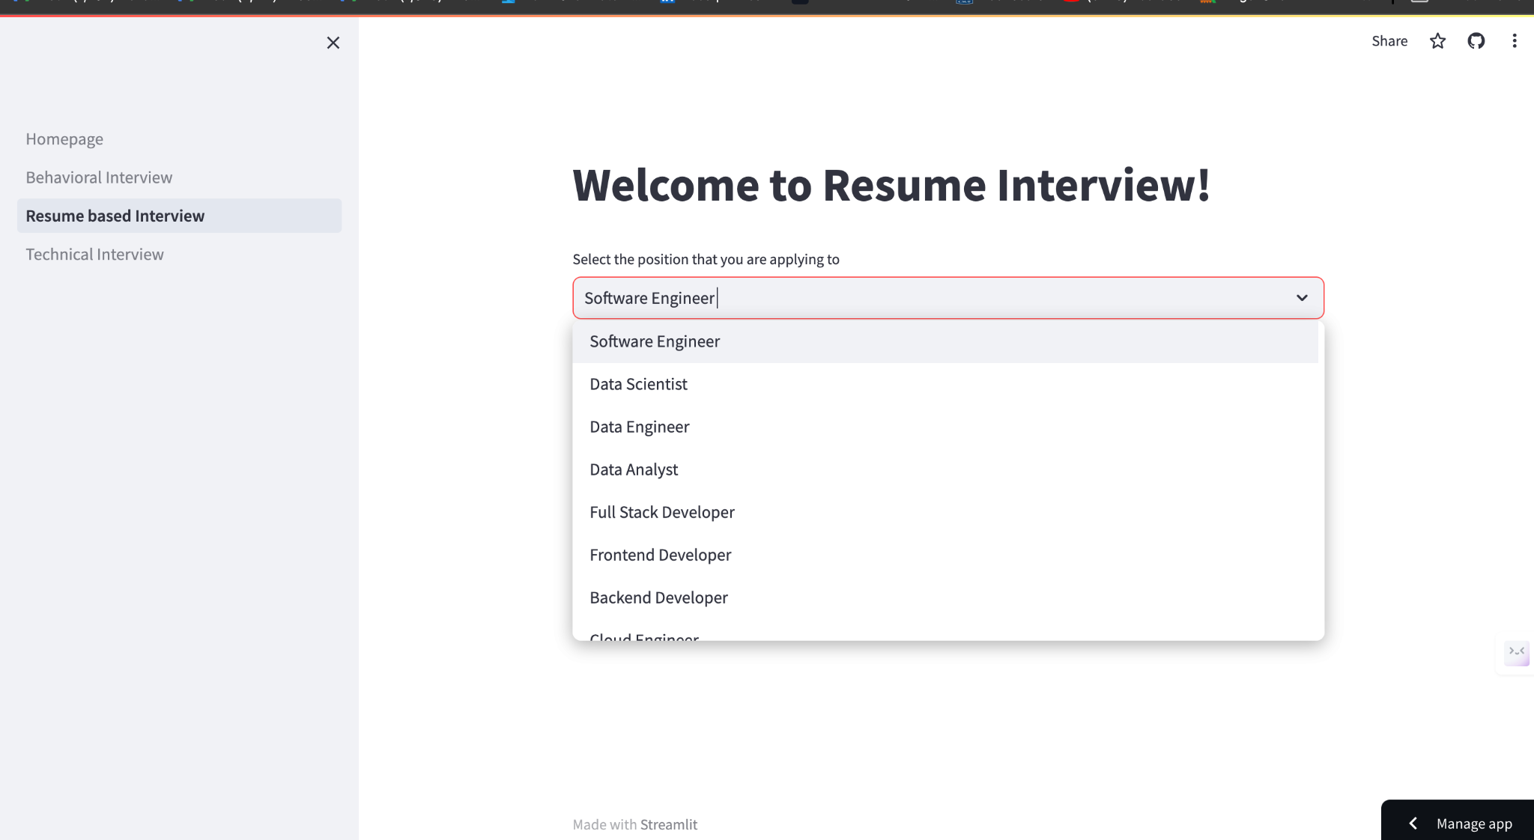

Slide 18
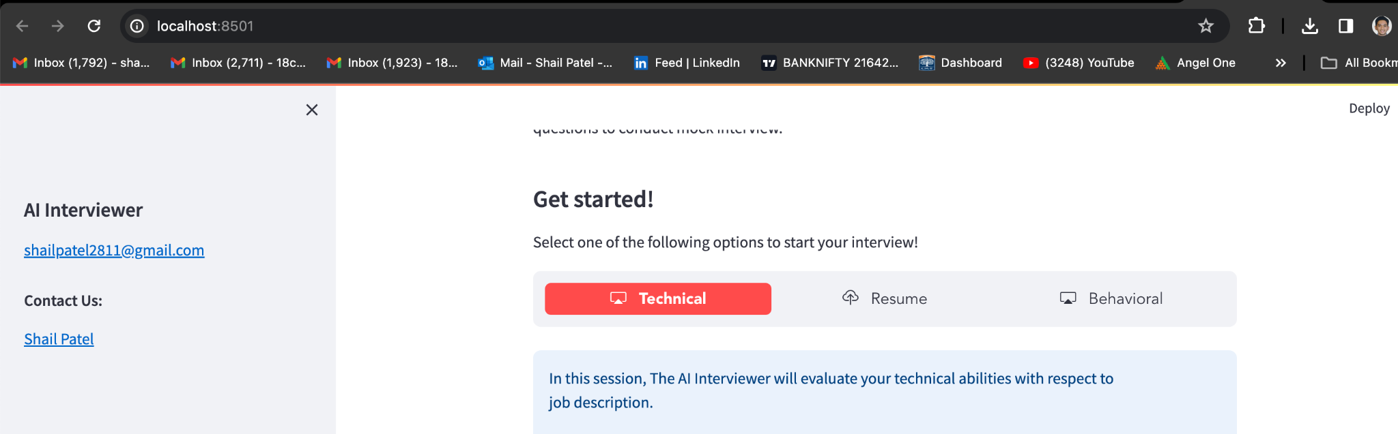
Local host link

Slide 19
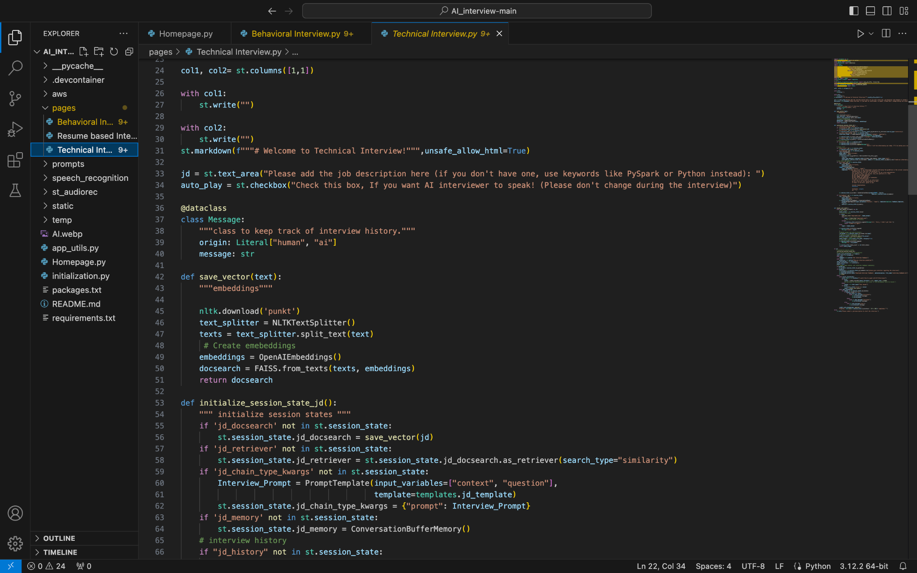
Technical Interview Page

Slide 20
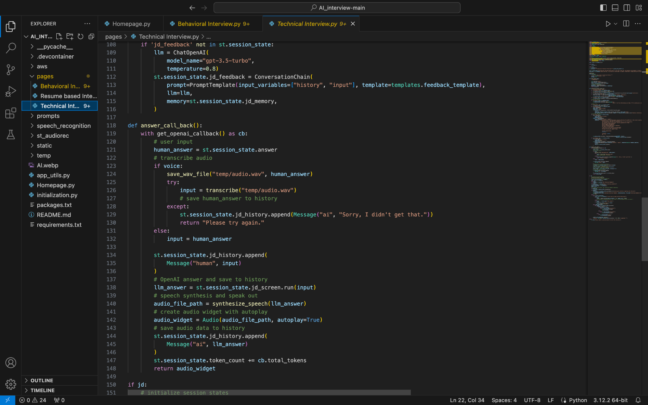

Slide 21
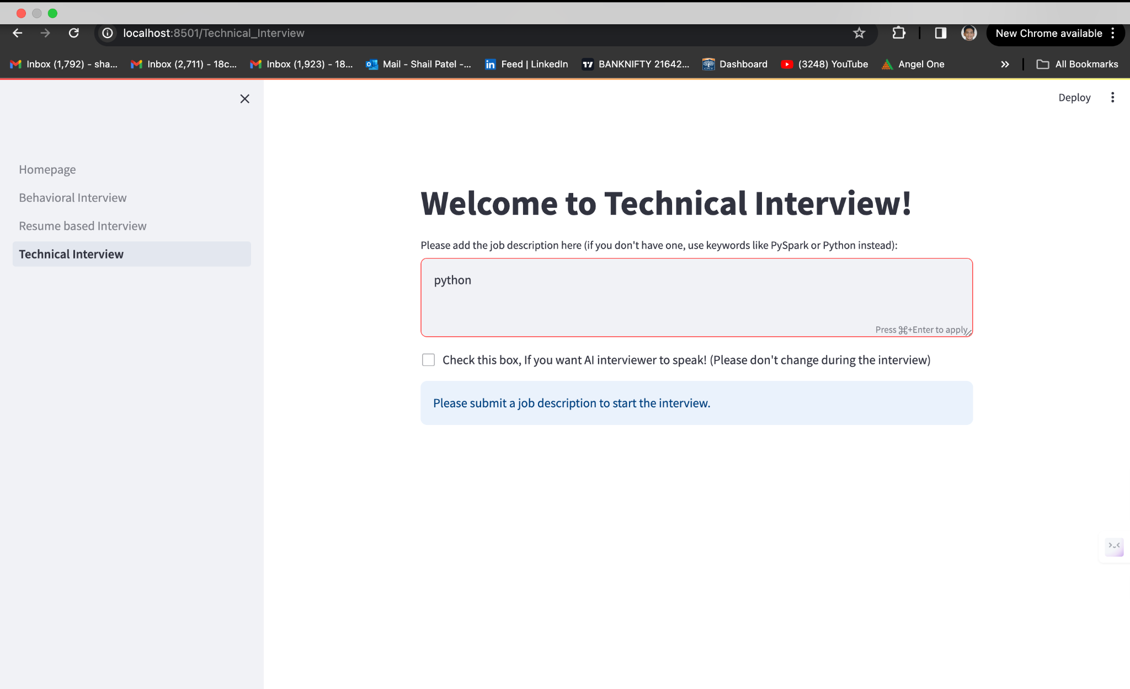

Slide 22
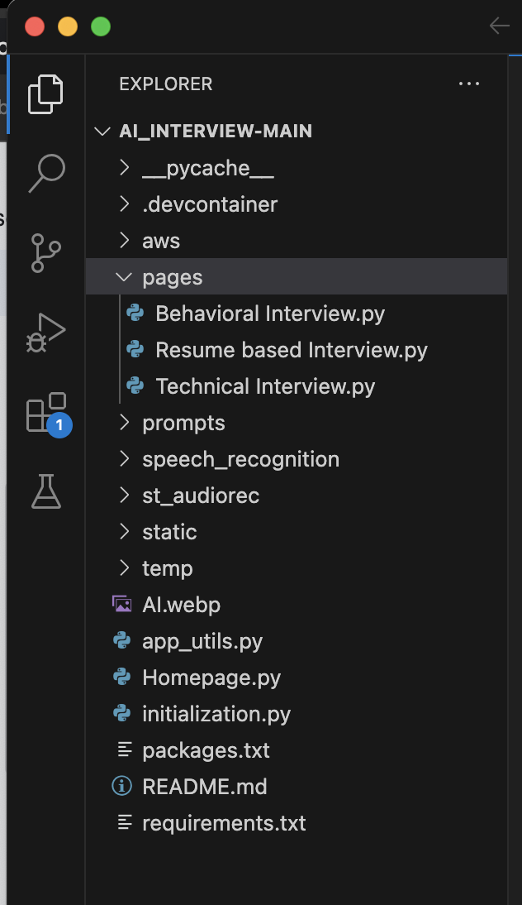
Pages

Slide 23
Thank You

